Slide 1
FIFA World Cup 2022 Prediction
Data Analytics Mini Project by Taher and Ujwal

Slide 2
INTRODUCTION
Our aim is to predict the outcomes of the forthcoming world cup games and to a predict each individual player ratings and to also find the similarity between given players as an additional feature

Slide 3
DATASETS
FIFA 22 Players dataset from Kaggle.
International matches between 1872 to 2022 from Kaggle.
Simple dataset of 32 world cup teams and which group they belong to.
Links:
https://www.kaggle.com/datasets/martj42/international-football-results-from-1872-to-2017
https://www.kaggle.com/datasets/stefanoleone992/fifa-22-complete-player-dataset?select=players_22.csv

Slide 4
APPROACH
Find the best players playing at the world cup from the FIFA 22 dataset.
Find the strongest teams by collating the best players from each country
Find the performances of teams by looking at historical data and seeing win percentage, FIFA Ranking, and offense and defense scores.
Training the model with the training data set and seeing accuracy
Test data will be the dataset of official matches that will take place in the world cup
Simulating the group stages and knockout stages

Slide 5
DATA PREPROCESSING AND EDA
The Players_22 dataset has several features we dont require, we will only take into account the most important ones such as overall rating, market value etc.
The data is used to generate squad strengths and rank the teams that will play in the Qatar World Cup.
A squad is generated for each team based on the overall ratings of players and potential ratings of players

Slide 6
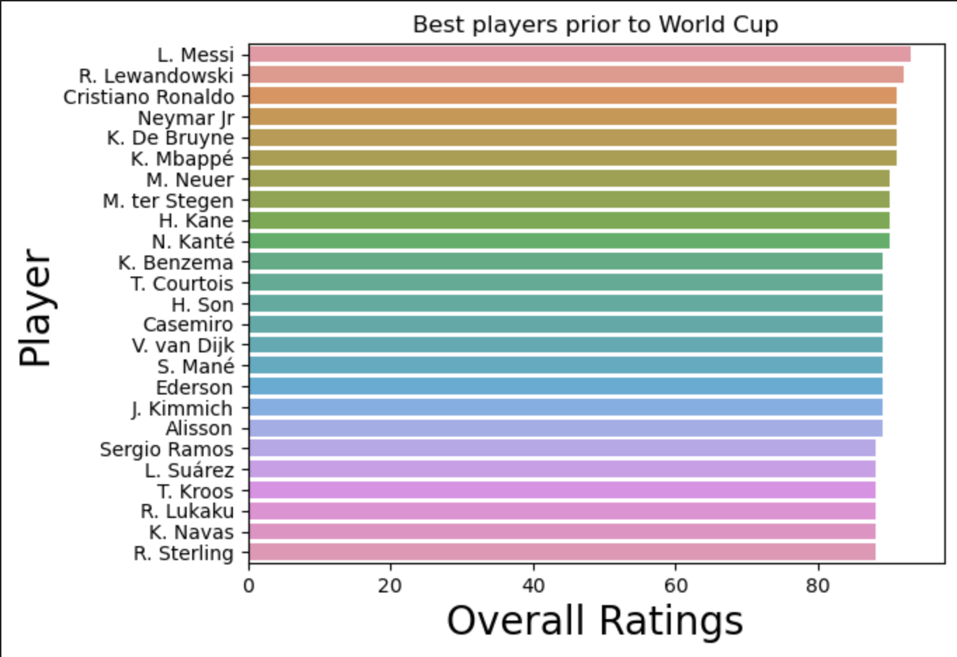
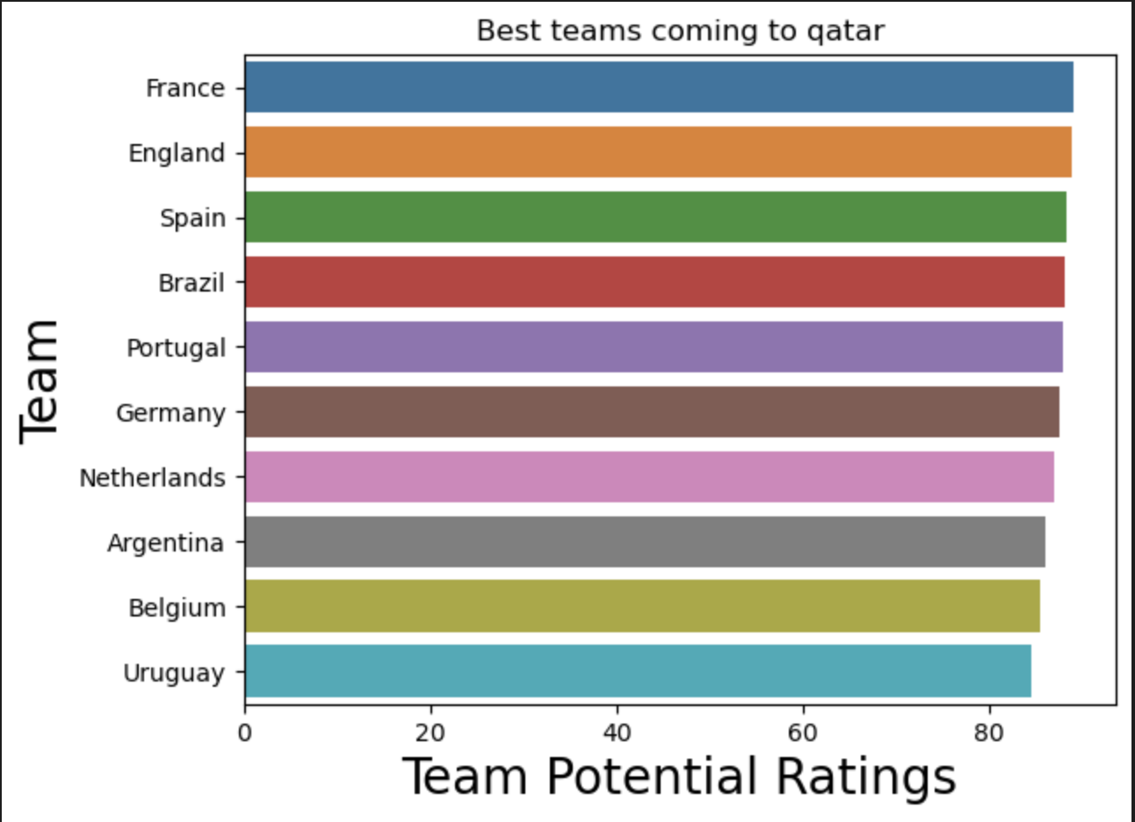

Slide 7
DATA PREPROCESSING AND EDA
The international matches dataset was used to generate a record of the form of teams that play in the world cup as well as look into the historical data of their performances
Best teams are ranked best on their winning percentage and their home and away record
The attack midfield and defensive abilities of each team is analyzed
Find correlation of the attributes to the FIFA Ranking of the teams

Slide 8
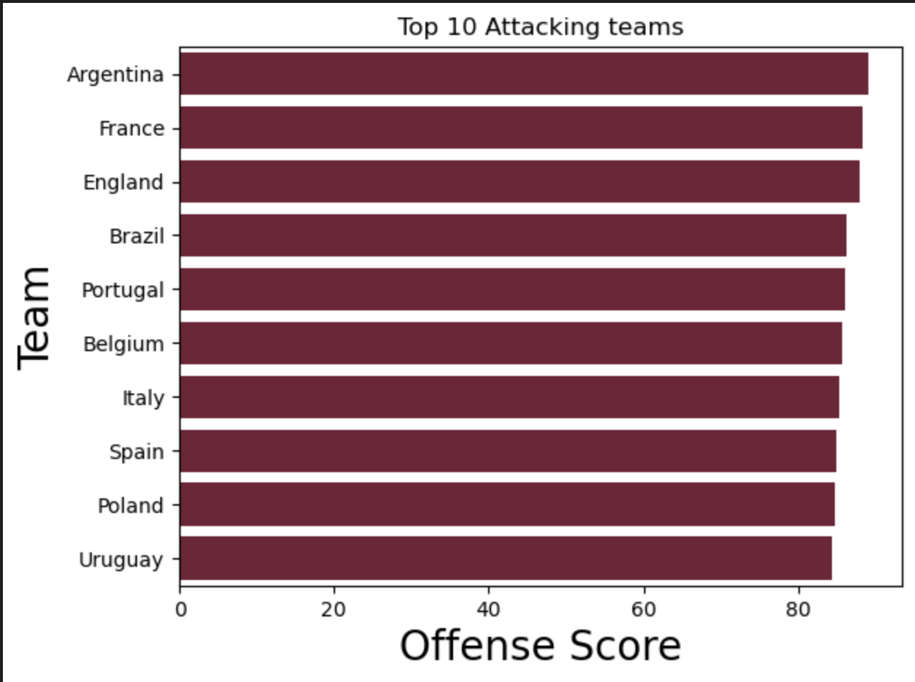
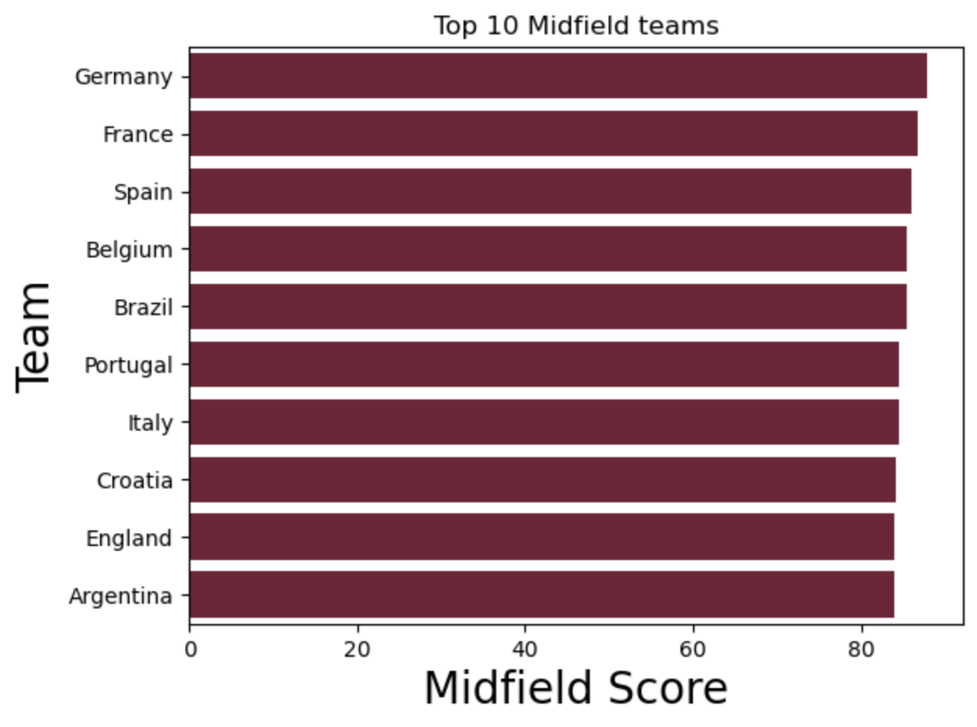
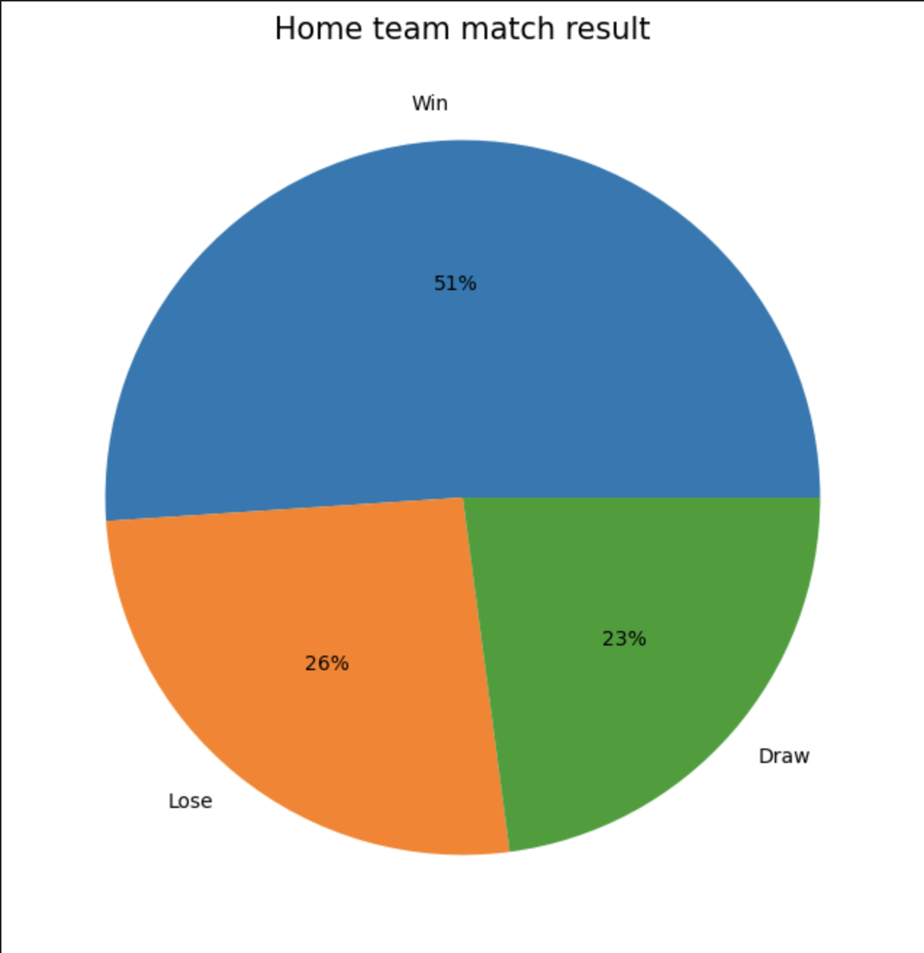

Slide 9
MODELS
The models used to make predictions are the Random Forest and XGBoost Models
XGBoost model is good at predicting the group stage matches with a high accuracy.
Random Forest Model is good at predicting the Knockout stage games with high accuracy.
We used Grid-Search to help us tune the Hyperparameters of the respective models (like gamma(lagrangian multiplier), learning rate )etc

Slide 10
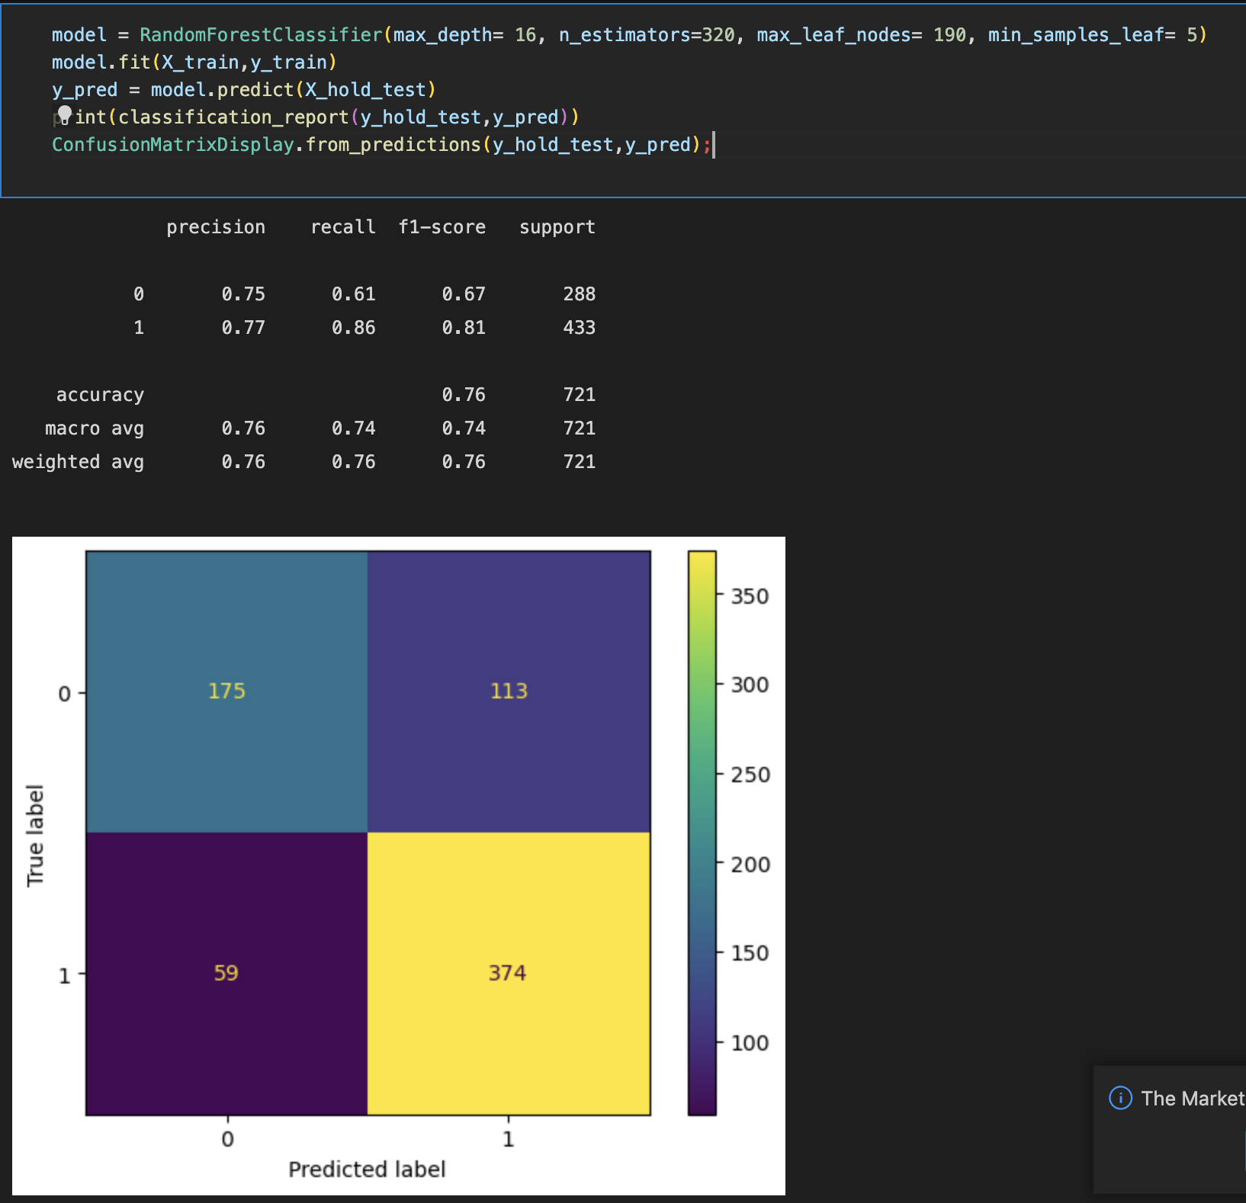
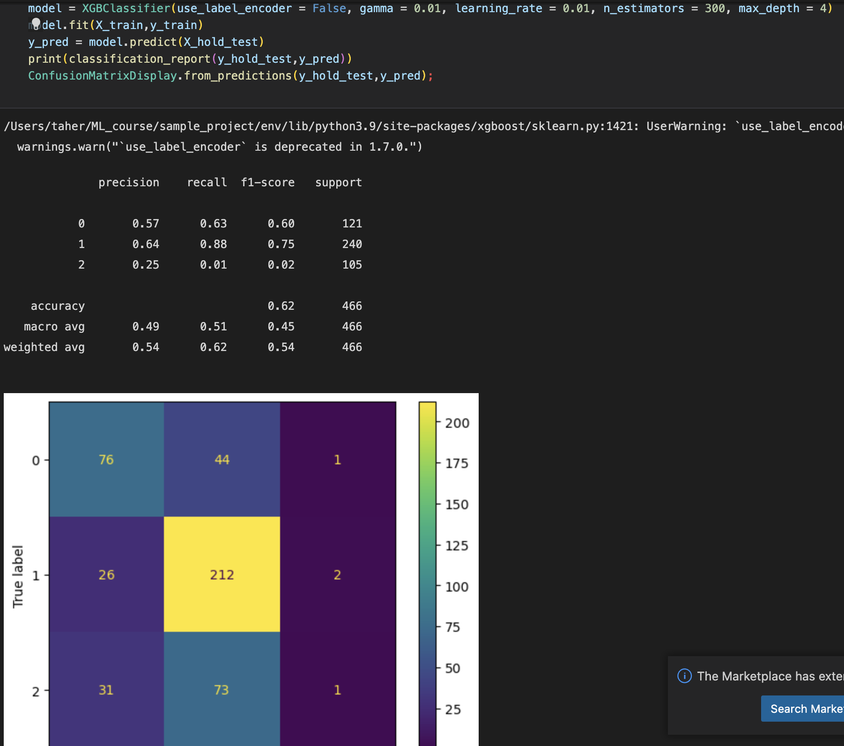

Slide 11
PREDICTIONS AND EVALUATION METRICS USED
Predicting the group stage :

Slide 12
Predicting the Knockout stage :

Slide 13
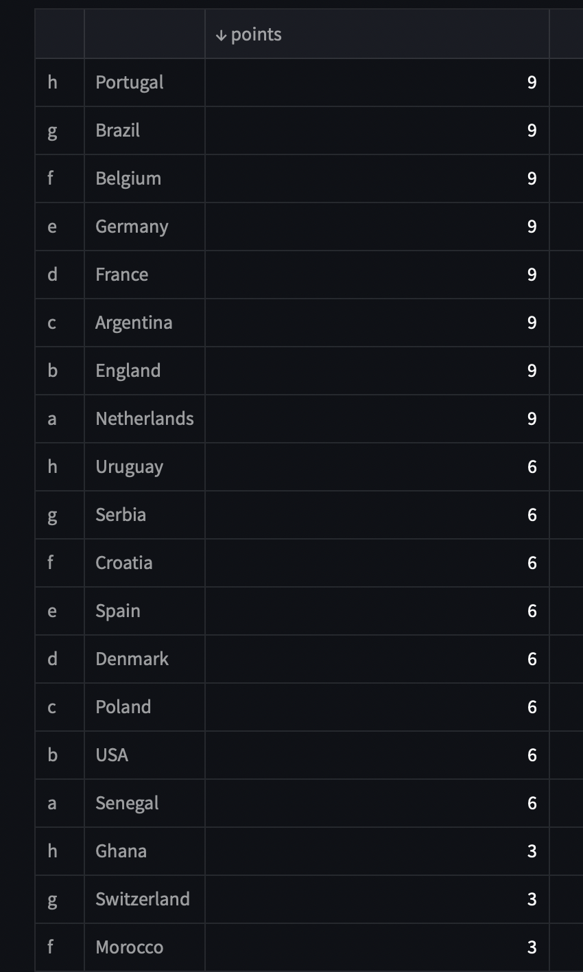
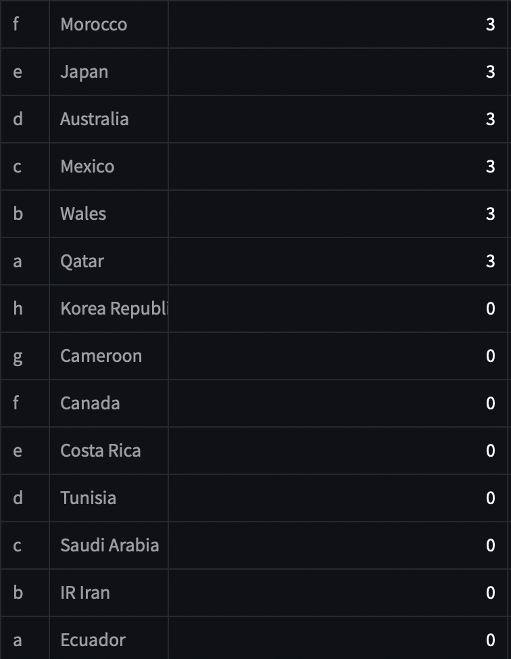

Slide 14
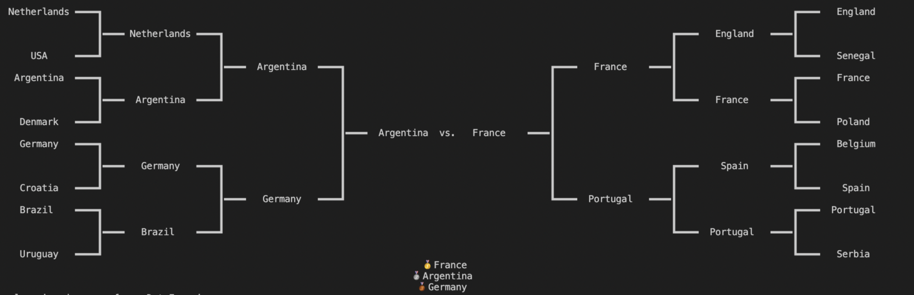
KNOCKOUT STAGES:

Slide 15
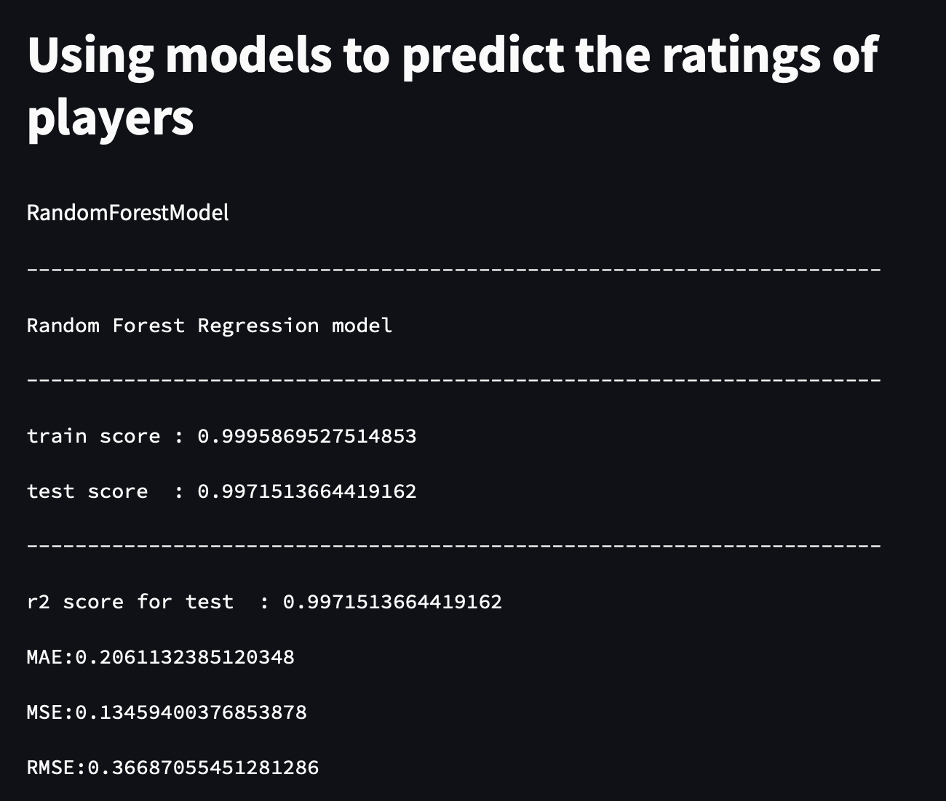
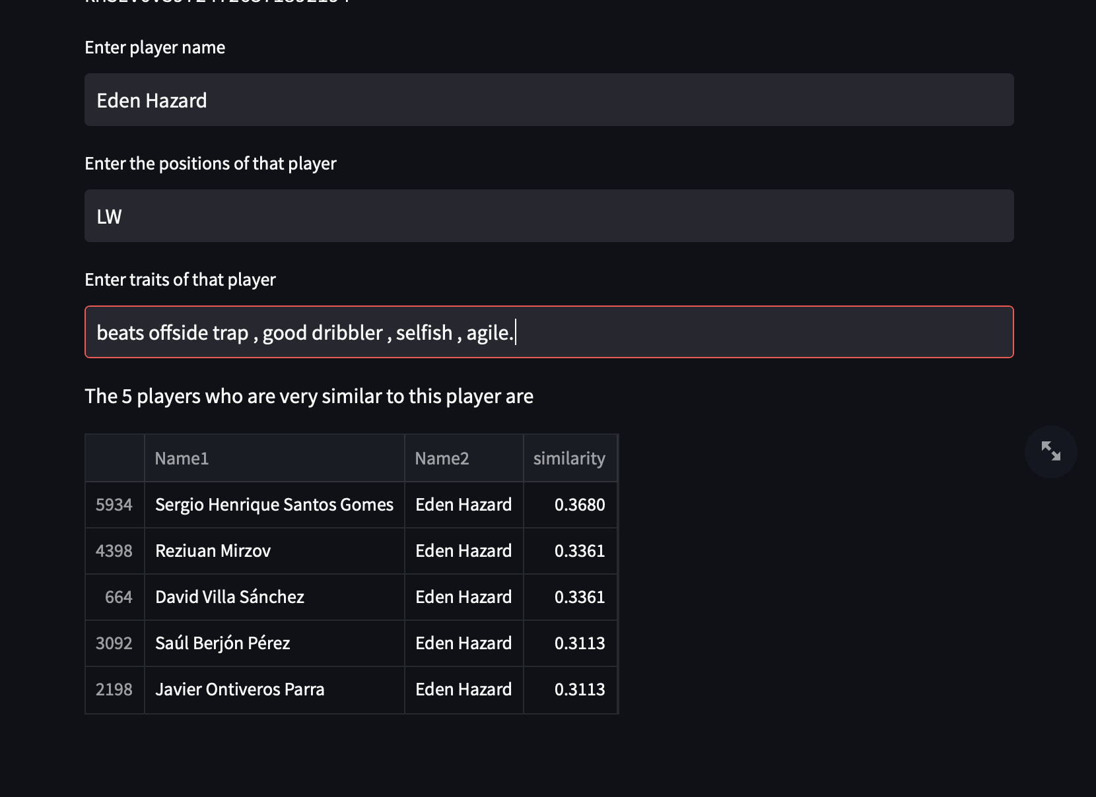
PREDICTING PLAYER RATINGS AND FINDING SIMILAR PLAYERS

Slide 16
CONCLUSION
Here we predicted the world cup outcomes and according to our models france has won the world cup yet again .We are yet to witness what happens in the upcoming world cup..will the world cup curse affect the title holders yet again? , will messi finally get his hands on the cup? , what if most of the predictions we made here come true ?, we’ll soon find out .

